Slide 1
R Workshop Session 1 Intro to R & rstudio
Anisha Khosla

Slide 2
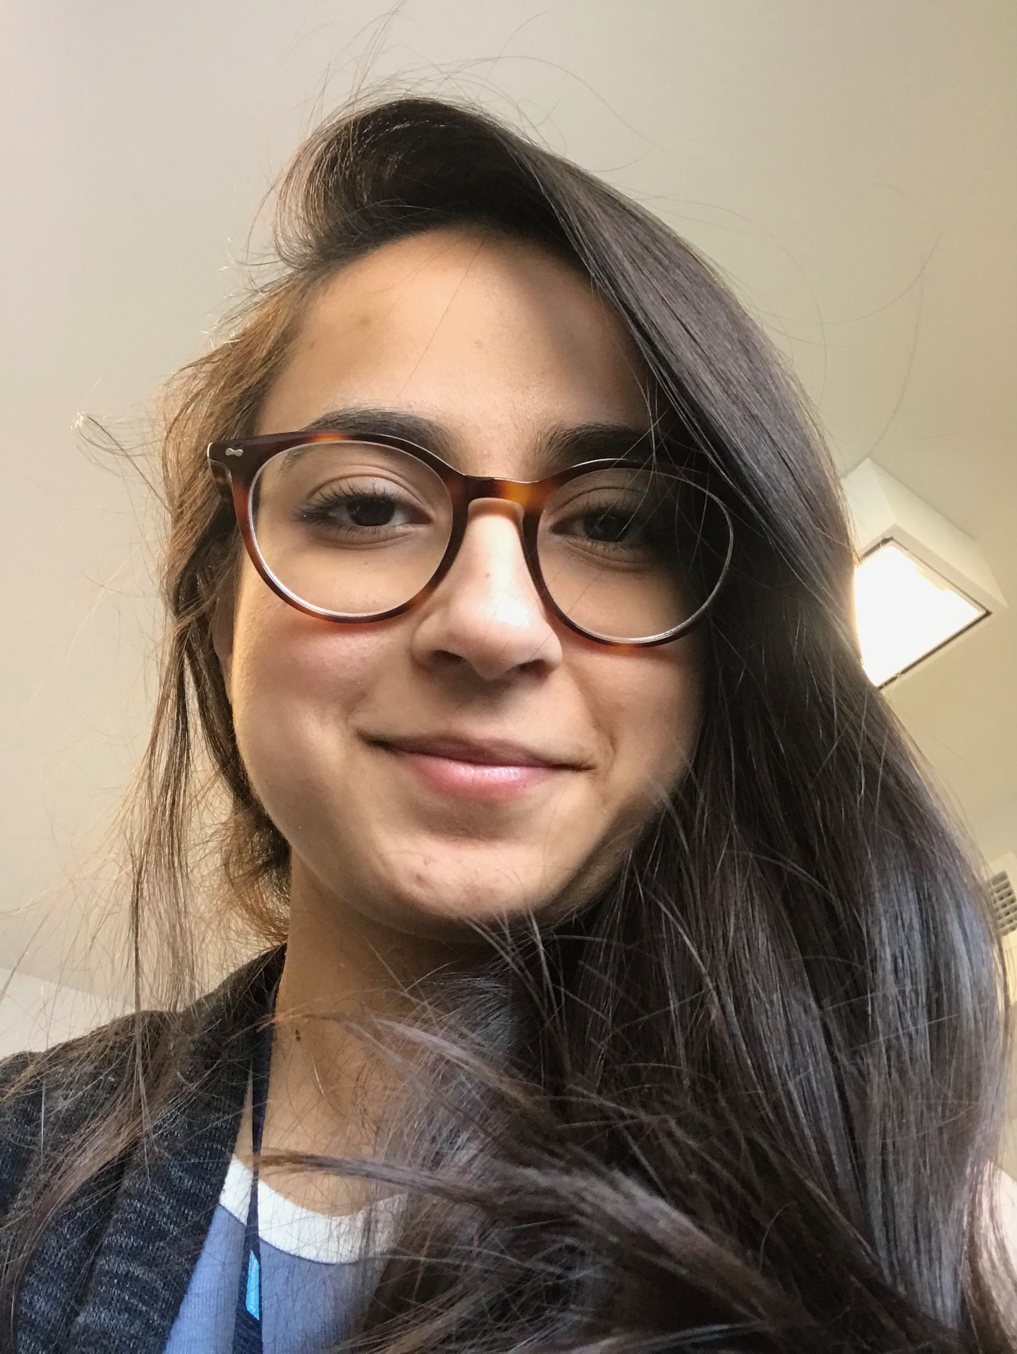


Who am i?
Anisha Khosla
PhD student at UofT with Jen Ryan and Morris Moscovitch
Outreach, R and Python workshop instructor
akhosla@research.baycrest.org
@khosla_anisha

Slide 3
R workshop series
Introduction to R, Rstudio, Nuts & Bolts: July 20th, Anisha Khosla
Data Wrangling and Analyses: July 22nd, Nichole Bouffard
Data Visualization: July 24th, Stephanie Simpson

Slide 4
Session 1 overview
Why R?
What is Rstudio?
Nuts and Bolts: data types, indexing
Working with data in R
Read in a CSV file
Explore dataframes
Packages: tidyverse

Slide 5
OPTIONS
skeleton R code (code with me) intro_skeleton.R
complete R code (follow along) intro_complete.R, intro_complete.pdf
R Markdown available (session 3) intro_complete.Rmd

Slide 6

Why r?
statistical programming language
faster, greater functionality, & more customizable than SPSS and Excel
R is popular in academia and industry
free and open-source
online community
sharing your analyses with others
always updating and improving
cons: learning curve, less intuitive than Python

Slide 7

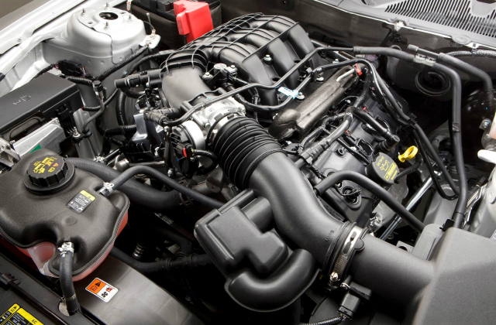
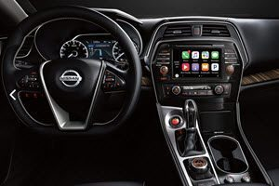
What is rstudio?
Engine
Dashboard

Slide 8
R workshop series
Introduction to R, Rstudio, Nuts & Bolts: July 20th, Anisha Khosla
Data Wrangling and Analyses: July 22nd, Nichole Bouffard
Data Visualization: July 24th, Stephanie Simpson
If you are new to programming, I recommend learning about:
GitHub
Documenting your code as a favor for future you
Questions?
akhosla@research.baycrest.org
@khosla_anisha

Slide 9
R Workshop Session 2
Nichole Bouffard

Slide 10
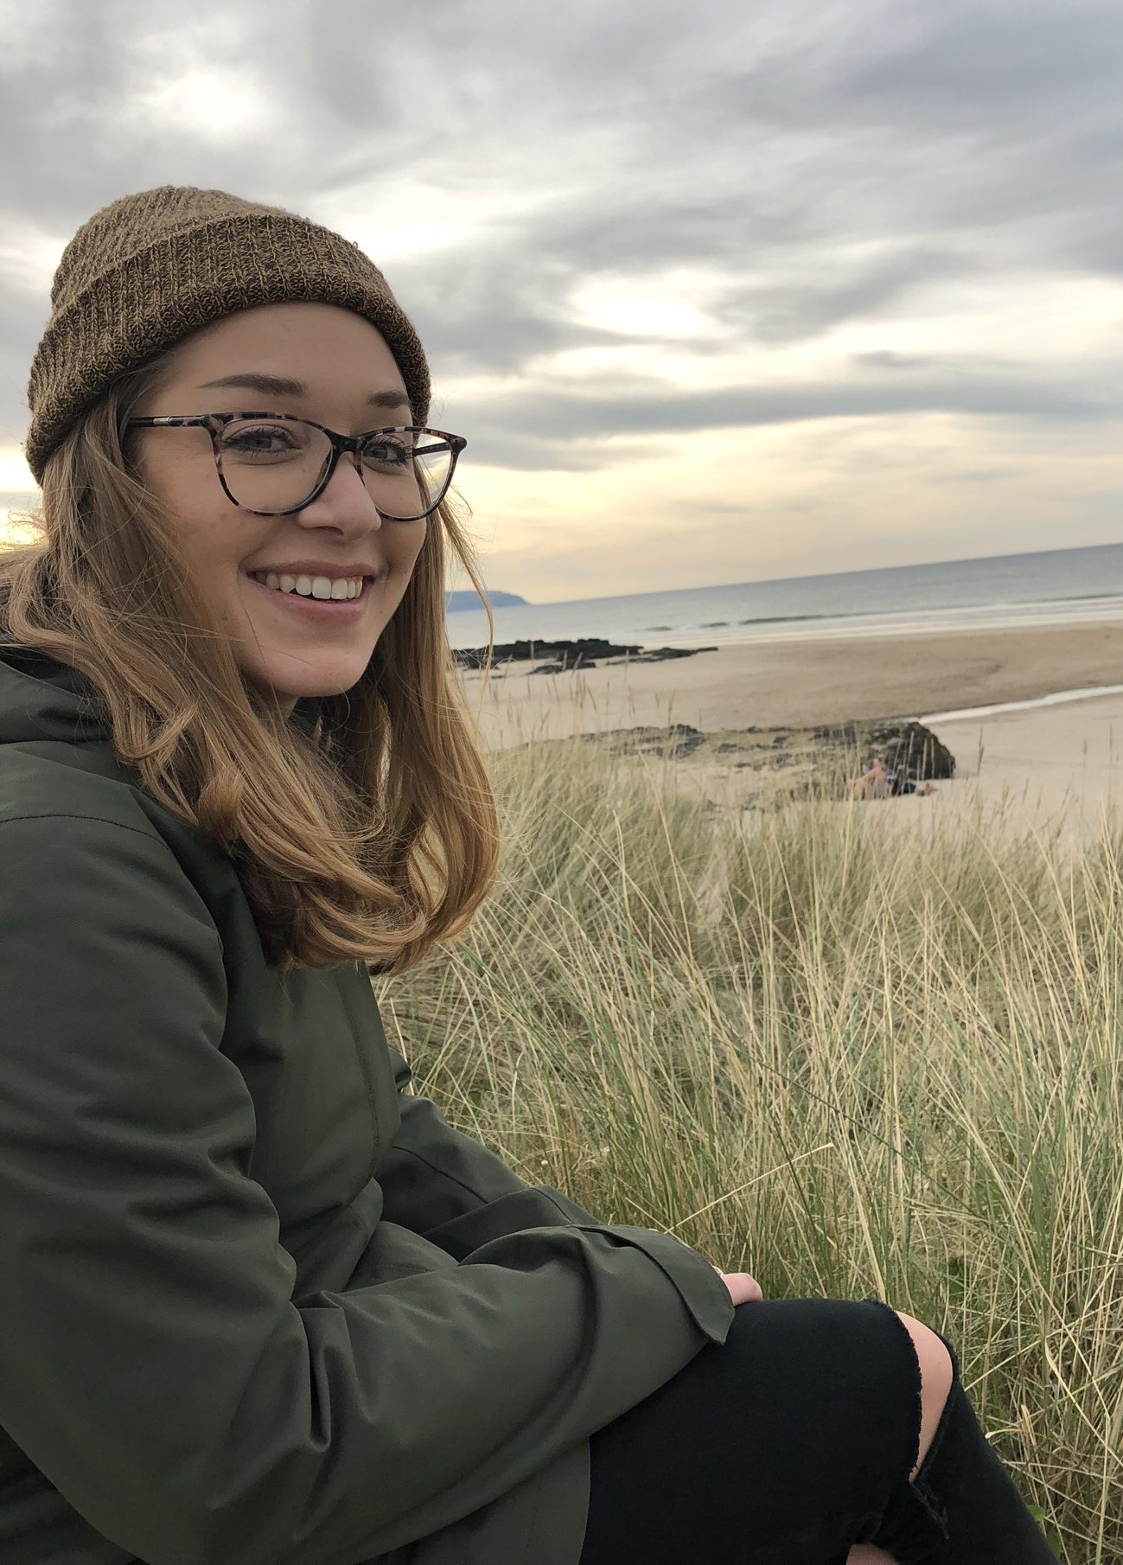
Who am i?
Nichole Bouffard
PhD student at UofT with Morgan Barense and Morris Moscovitch
R workshop instructor
nichole.bouffard@mail.utoronto.ca
@NicholeBouffard

Slide 11
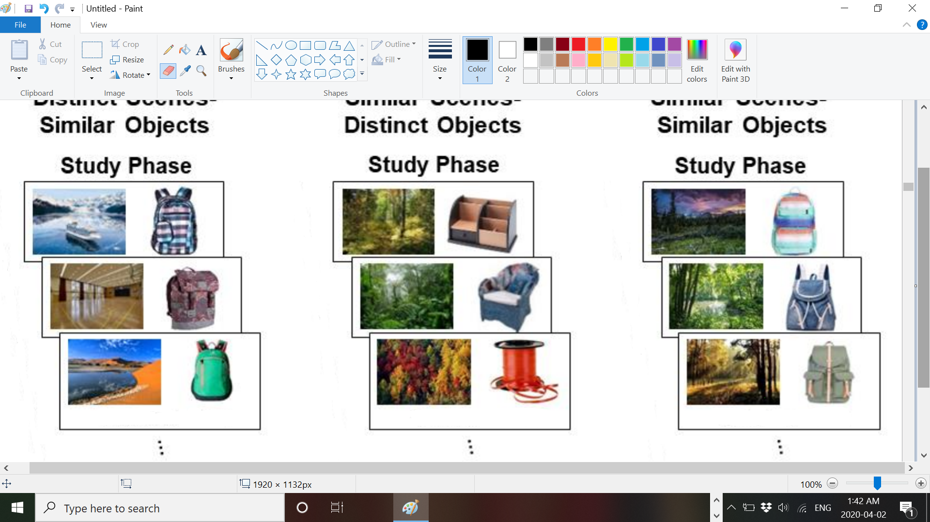
Experiment design
Younger adults (YAs; N = 31), Older Adults (OAs; N = 28)
6 study-test blocks
2 blocks of each condition
Distinct scenes - Similar objects
(DS-SO )
Similar scenes - Distinct objects
(SS-DO)
Similar scenes - Similar objects
(SS-SO)

Slide 12
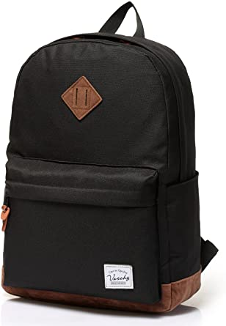

Study phase
Imagine a scenario where this bag is interacting in this scene in some way
Rate vividness from 1 - 6

Slide 13
Test phase
66 trials per block. 42 trials were old objects, 24 were new
Recognition memory tested for objects and scenes, and associative memory
Single Item Recognition
Associative Memory
Have you seen this object before?
Were these previously paired together?
R F N
Yes No

Slide 14
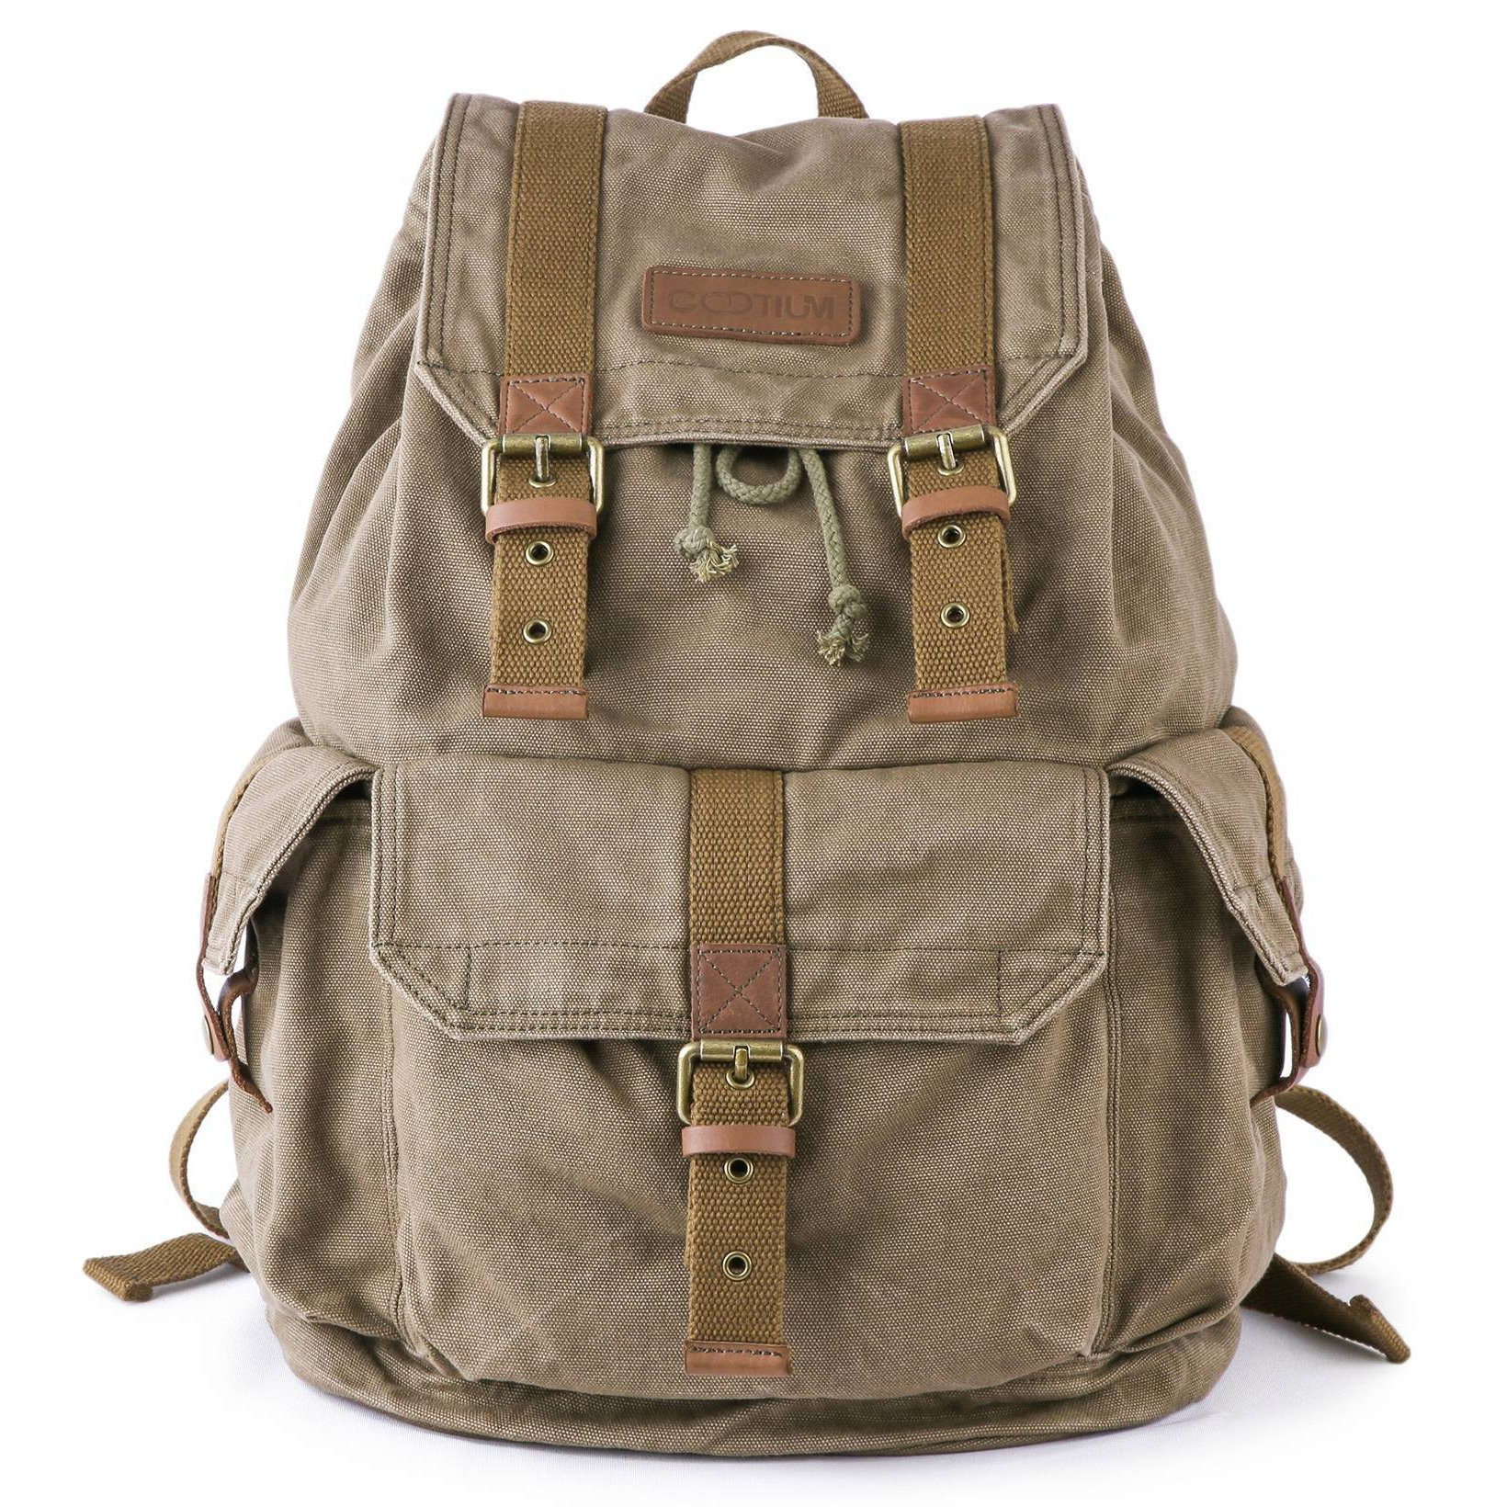


Data: Single item recognition
DV: Proportion of Hits – False alarms
Hit
False alarm
OLD
NEW
Have you seen this object before?
Have you seen this object before?
R F N
R F N

Slide 15


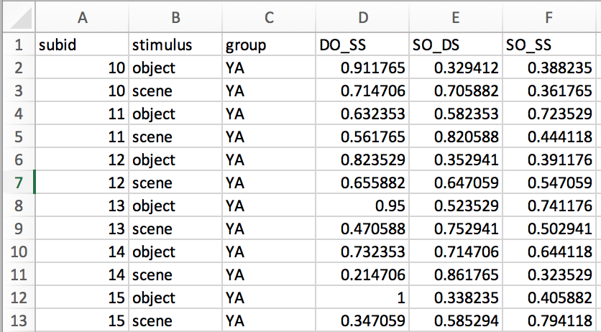
Data: Single item recognition
Distinct Object/Similar Scene
Similar Object/Distinct Scene
Similar Object/Similar Scene
Subject identifier
object or scene
YA or OA
Hit-FA

Slide 16
Session 2 Objectives
Packages: tidyverse, ez, afex, emmeans
Calculating descriptive statistics
ANOVAs and t tests
Is there a significant difference in memory performance between the levels of our factors?
Main effect of age? (YA vs. OA)
Main effect of stimulus? (objects vs. scenes)
Main effect of condition? (DO_SS, SO_DS, or SO_SS)
Simple plots

Slide 17
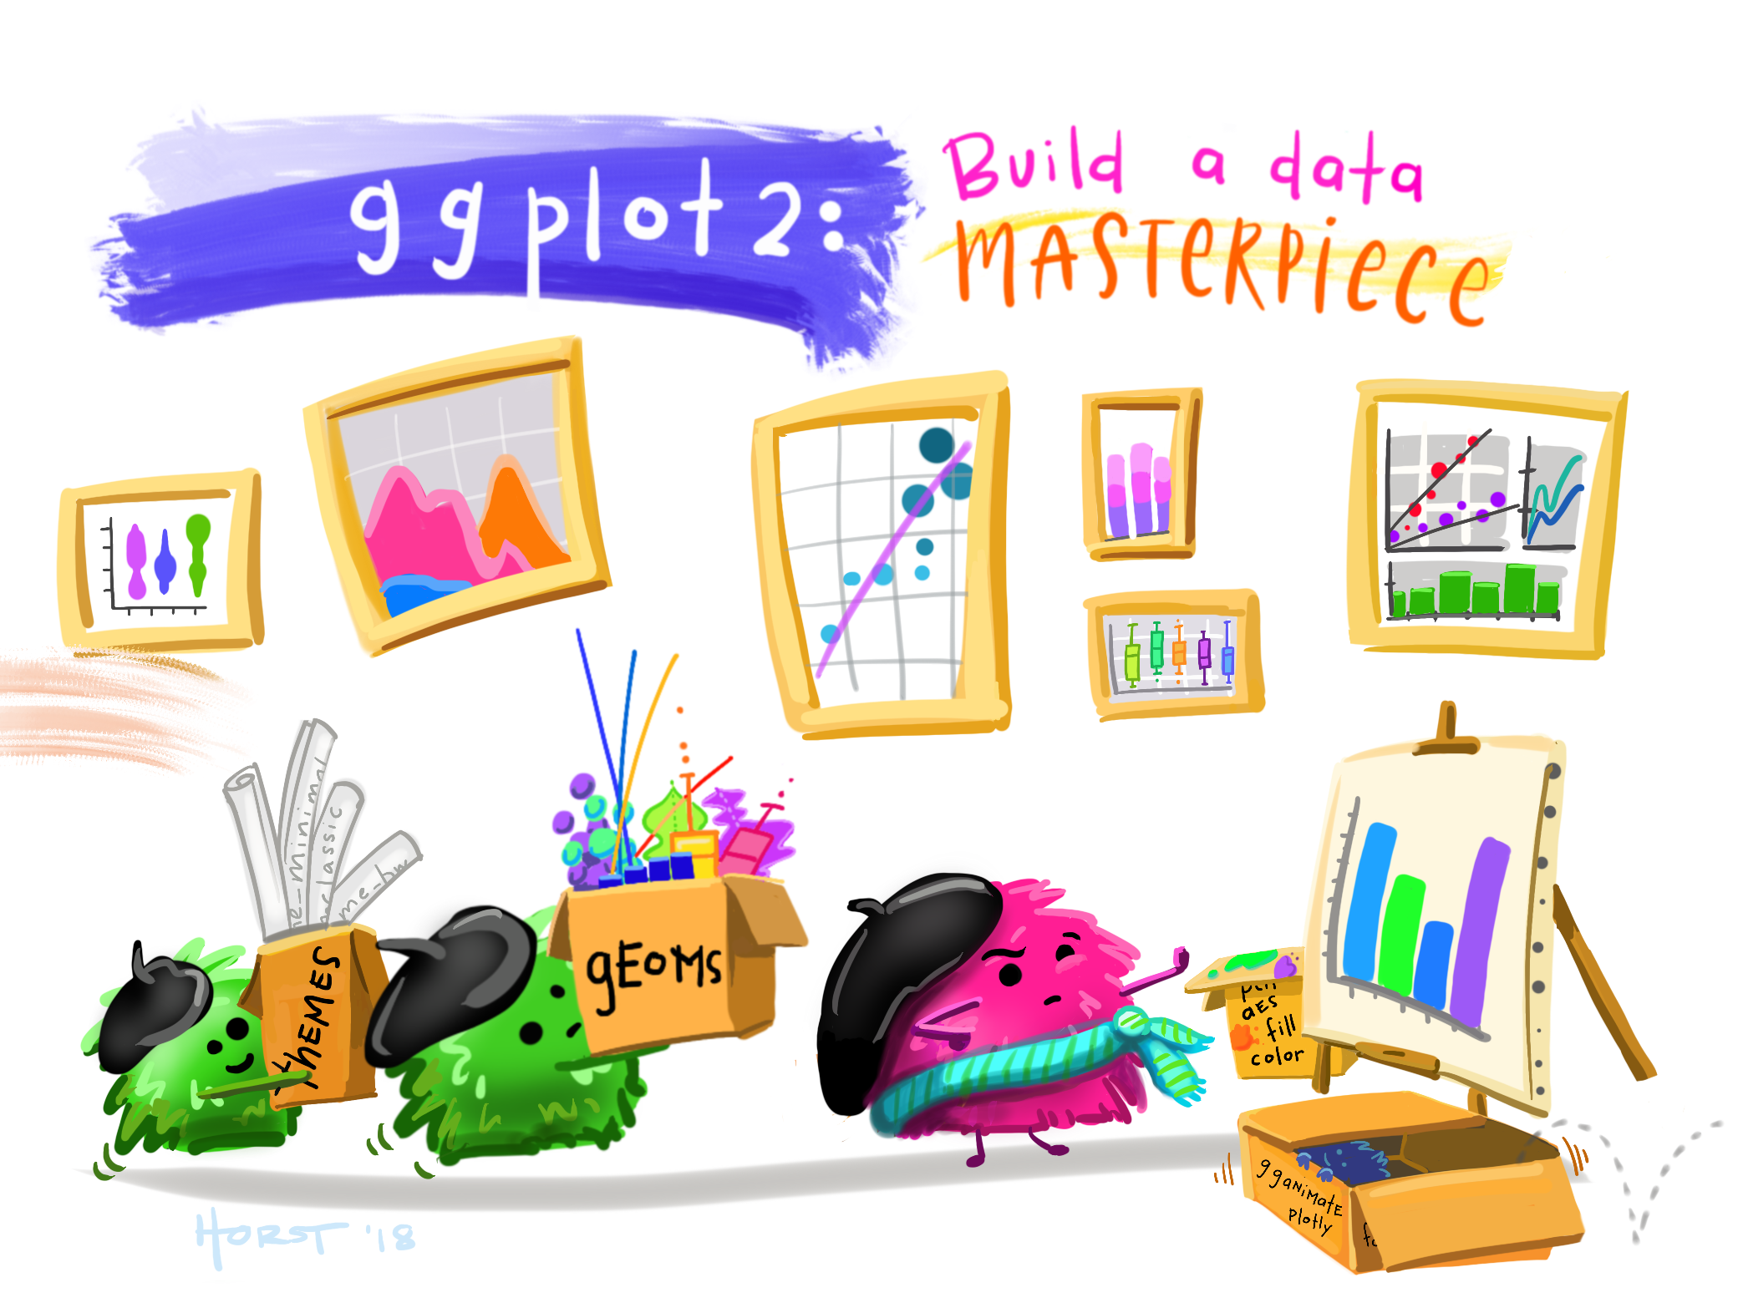
R workshop session 3: data visualization
Artwork by Allison Horst
https://github.com/allisonhorst/stats-illustrations

Slide 18
Who am I?
Stephanie Simpson ssimpson@research.baycrest.org
Graduate student in the Levine Lab studying the influence of sleep on episodic memory
Standing committee member of the Rotman Training Centre (RTC)

Slide 19
Session 3 aims
Learn how to make a:
Bar plot
Box plot
Scatterplot
Know how to:
Combine graphs into one figure
Save your figure
R Markdown (if there is time)
15-min Q & A at the end

Slide 20
Access files on the drive
https://drive.google.com/drive/u/1/folders/1uSbZTxfB_EmAQW36ipWXC5yJec843CxC
Feel free to download the base R script or the PDF to follow along with me during the session
Don’t worry about live-coding with me if this is your first time!

Slide 21
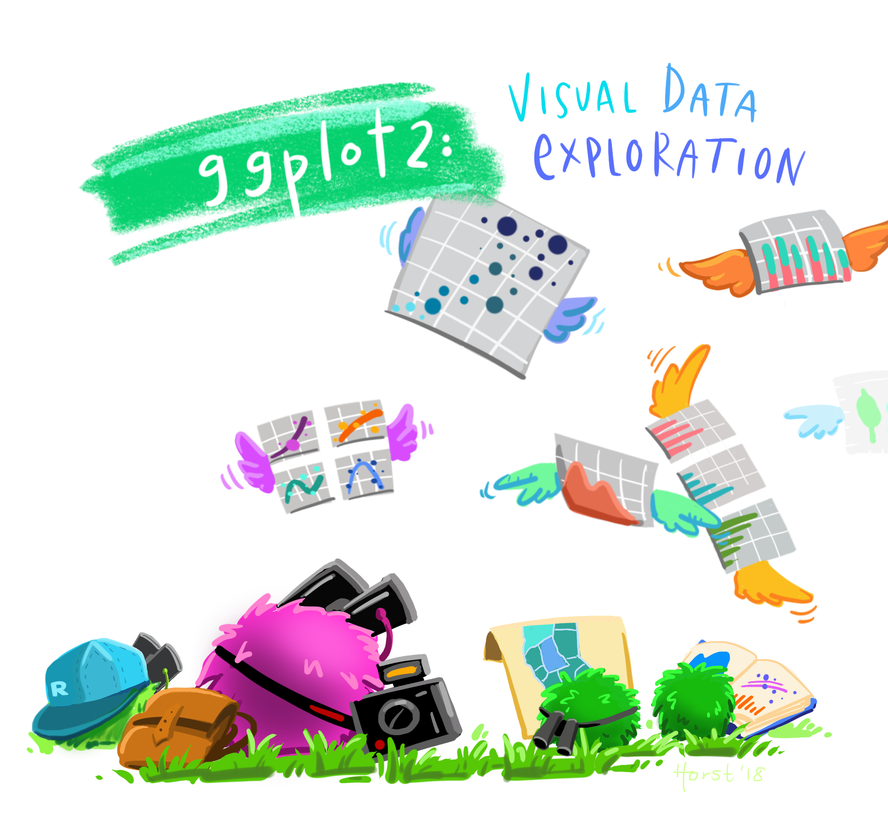
Let’s begin!
Artwork by Allison Horst
https://github.com/allisonhorst/stats-illustrations

